Slide 1
RADAR ON ROADS
PIP2001 Capstone Project
Review-4
Batch Number: CCS-G28
Roll Number | Name of Student
20211CCS0017 | M Sonali
20211CCS0026 | Bhavana MM
20211CCS0034 | Jakku Nishithaa
20211CCS0153 | Hiranmayi R
Under the Supervision of,
Nagaraja S R
Associate Professor
School of Computer Science and Engineering
Presidency University
Name of the Program: Computer Science and Engineering Spl. Cyber Security
Name of the HoD: Dr. S P Anandaraj
Name of the Program Project Coordinator: Dr.Sharmasth Vali Y
Name of the School Project Coordinators: Dr. Sampath A K

Slide 2
Content.
Problem Statement.
Analysis of Problem Statement.
Literature Survey.
Research Gap in Existing Model.
Proposed Method.
Architecture.
Objectives.
Outcomes.
Timeline of the Project.
Conclusion.
Github Link.
References.
Project work mapping with SDG.

Slide 3
Problem Statement Number: PSCS42.
Organization: LTI MindTree
Category : Hardware/Software
Problem Description: Traditional toll collection systems face challenges such as overcrowding, manual transaction inefficiencies, and increased vehicle emissions. Long wait times lead to frustration and environmental concerns, while reliance on cash transactions results in human errors and revenue losses. The proposed automated toll collection scheme utilizes advanced radar, GPS, and GSM technology to enable seamless vehicle detection and classification, improving traffic flow, user experience, and promoting environmental sustainability by reducing idling and emissions.
Difficulty Level: Complex

Slide 4
Analysis of Problem Statement.
Problem Statement: The project addresses significant challenge in traditional cost ingathering scheme, which often extend to over-crowding, recollective wait sentence, and inefficiency due to manual transactions. These issues contribute to increased vehicle emission and revenue inaccuracies from human erroneous belief and fraud. By integrate advanced radar technology with GPS and GSM, the proposed automate bell collection scheme enables seamless vehicle detection and classification, appropriate vehicle to kick the bucket through toll plazas without blockade. This forward-looking feeler heighten traffic flow, ameliorate exploiter experience, ensures exact toll collection, and kick upstairs environmental sustainability by reducing idling meter and associated emissions.
Key Features:
Seamless Vehicle Detection
Electronic Payment Processing
Real-Time Notifications
Traffic Flow Optimization
Integration with Navigation Systems
Data Analytics for Revenue Management

Slide 5
Analysis of Problem Statement (cont...)
Technology Stack Components:
Hardware Requirments:
•GPS Technology:
•Utilizes the NEO-6M GPS module to track real-time vehicle location and calculate distance traveled.
•GSM Communication:
•SIM800C GSM module for transmitting toll data, entry/exit notifications, and real-time fare updates to a central server.
•Display System:
•JHD 204A LCD Display (20x4) for showing real-time GPS coordinates, distance traveled, and toll fare to the driver.

Slide 6
Analysis of Problem Statement (cont...)
Software Requirments:
The system software manages GPS tracking, fare calculation, and communication with a central toll system.
•GPS Data Processing:
Processes real-time GPS coordinates received from the NEO-6M GPS module, calculates the distance traveled, and stores the information.
•Fare Calculation Logic:
Implements algorithms to calculate the toll based on the distance traveled. The fare is updated every 10 km and displayed to the driver in real-time.
•GSM Communication:
Controls the SIM800C GSM module to transmit toll information (entry/exit data, fare updates) to the central server and send SMS notifications to the driver.

Slide 7
Analysis of Problem Statement (cont...)
Display and Notification Management:
Manages the JHD 204A LCD to show real-time information like GPS coordinates, distance, and fare.
•IoT Integration Protocols:
Implements communication protocols to connect the ESP32 with a remote server for real-time toll data transmission and remote monitoring.

Slide 8
Literature Survey.
Introduction to Radar Technology
Definition & Origins: Radar (Radio Detection and Ranging) uses electromagnetic waves to detect objects.
Historical Foundations:
1886: Heinrich Hertz demonstrated radio waves’ reflection and refraction.
1904: Christian Hülsmeyer patented the "Telemobiloskop," an early radar device.
World War II Advancements:
RADAR term coined by the U.S. Navy (1940).
Key development: cavity magnetron (1939) for compact, efficient radar systems.

Slide 9
Literature Survey (cont…)
Post-War Civilian Applications
Air Traffic Control (1950s): FAA used radar to improve safety and manage aviation traffic.
Law Enforcement: Radar guns introduced for speed monitoring, enhancing road safety.
Weather Forecasting: Radar adapted for meteorological monitoring, revolutionizing predictions.

Slide 10
Literature Survey (cont…)
Radar in Traffic Management
Modern Applications:
Detects vehicle speed, direction, and classification under various conditions.
Supports urban mobility through real-time traffic monitoring.
Types of Radar Systems:
CW Radar: Simple, cost-effective for speed measurement.
FMCW Radar: Measures distance and speed; robust in adverse conditions.
Pulsed Radar: Long-range detection; ideal for highways.
MIMO Radar: High accuracy, 3D imaging for complex urban environments.
Integrated Systems: Combines radar with cameras for enhanced analytics.

Slide 11
Literature Survey (cont…)
Integration with Other Technologies
GPS & GSM: Improved localization and obstacle detection.
Sensor Fusion: Merging radar with cameras enhances pedestrian detection and traffic flow analysis.
Collaborative Systems: Networked radars extend detection range and ensure redundancy.

Slide 12
Literature Survey (cont…)
Challenges & Limitations
Environmental Interference: Rain, fog, and urban clutter can reduce accuracy.
Resolution Limitations: Difficulty distinguishing closely spaced objects.
Deployment Issues: Requires line-of-sight and precise placement.
High Costs: Significant initial investment and maintenance expenses.

Slide 13
Literature Survey (cont…)
Real-World Implementations
Smart Cities: Radar-based traffic flow monitoring in Glasgow.
Pedestrian & Cyclist Safety: Radar for bike counts and crossing safety.
Intersection Management: Adaptive traffic lights using radar data.
Speed Enforcement: Radar-enabled systems for tracking violations.
Mobile Applications: Wireless radar device management for ease of use.
Intelligent Transport Systems (ITS): Integrated radar for bus prioritization in Cardiff.

Slide 14
Research Gap in Existing Model.
Inadequate Consideration of Environmental Factors
Key Issue:
Traffic prediction models often ignore environmental factors like rain, snow, and fog.
Impact:
Adverse weather conditions significantly affect traffic flow and congestion patterns.
Existing models result in traffic flow prediction errors.
Solution:
Incorporate live environmental data to enhance prediction accuracy.

Slide 15
Research Gap in Existing Model(cont...)
Limited Focus on Dynamic Traffic Patterns
Key Issue:
Models fail to adapt to the dynamic nature of urban traffic.
Lack of real-time responsiveness to changing traffic conditions.
Impact:
Reduced effectiveness in handling fluctuating congestion levels.
Solution:
Develop adaptive models that consider evolving traffic patterns.

Slide 16
Research Gap in Existing Model(cont...)
Challenges in Data Utilization and Real-Time Processing
Data Utilization Challenges:
Models rely on small datasets, limiting diversity in traffic scenarios.
Ignoring data completeness reduces model effectiveness.
Real-Time Processing Challenges:
Computational inefficiency in handling large-scale sensor data.
Focus on accuracy over speed delays timely decisions.
Solution:
Utilize massive datasets with robust handling of missing data.
Develop efficient algorithms for real-time traffic processing.

Slide 17
Research Gap in Existing Model(cont...)
Inadequate Modeling of Congestion Patterns
Key Issue:
Limited studies on congestion dynamics, especially in urban intersections.
Current models fail to capture the evolution of congestion over time.
Impact:
Missed opportunities to optimize traffic control and reduce congestion.
Solution:
Focus research on congestion dynamics and apply predictive models to urban settings.

Slide 18
Research Gap in Existing Model(cont...)
Insufficient Focus on Non-Motorized Road Users
Key Issue:
Traffic monitoring focuses predominantly on motorized vehicles.
Pedestrians and cyclists are often overlooked.
Impact:
Increased risk to vulnerable road users and limited road safety insights.
Solution:
Design integrated systems that monitor both motorized and non-motorized users.

Slide 19
Proposed Method.
System Architecture
Key Components:
Vehicle Tracking Units:
Equipped with GPS receivers for location data and GSM modules for communication.
Integrated into navigation systems or standalone devices.
Central Traffic Management Server:
Collects and processes data for vehicle positions, speeds, and routes.
Integrates historical traffic and environmental data.
Data Analytics Platform:
Identifies traffic patterns, predicts congestion, and optimizes flow using machine learning.
User Interface:
Real-time updates, alternative routing suggestions, and incident alerts for drivers and authorities.

Slide 20
Proposed Method(cont...)
Data Collection Process
Steps Involved:
Real-Time Positioning:
GPS logs vehicle data (latitude, longitude, speed) at intervals.
Data Transmission:
GSM modules send data to the central server in real-time.
Data Aggregation:
Central server combines data to create a traffic overview.
Map-Matching Techniques:
Algorithms align GPS data with actual road segments for precise traffic flow analysis.

Slide 21
Proposed Method(cont...)
Traffic Flow Analysis
Key Insights Derived:
Congestion Detection:
Monitors speed drops and alerts for potential congestion.
Incident Reporting:
Detects accidents or blockages using sudden speed changes.
Predictive Analytics:
Predicts congestion patterns based on real-time and historical data.
Dynamic Routing Recommendations:
Suggests alternative routes via apps or in-vehicle displays to alleviate congestion.

Slide 22
Proposed Method(cont...)
Toll Collection Integration
Automated Tolling Features:
Seamless Tolling Process:
GNSS tracks vehicles for distance-based toll calculation without stops.
Automatic Deductions:
Tolls deducted from prepaid accounts (e.g., FASTag, digital wallets).
Dynamic Pricing Models:
Adjusts toll rates based on traffic demand (e.g., peak vs. off-peak).

Slide 23
Proposed Method(cont...)
Environmental Impact & Challenges
Environmental Benefits:
Reduced Emissions:
Minimizes idling and congestion.
Fuel Efficiency:
Optimized routes save fuel.
Data-Driven Planning:
Guides infrastructure investments based on real usage trends.
Challenges:
Privacy Concerns:
Address data security and transparency.
Technical Reliability:
Ensure GPS and GSM performance under varying conditions.
Cost Implications:
High initial investment but potential long-term savings.
Public Acceptance:
Communicate benefits and ensure fair pricing.

Slide 24
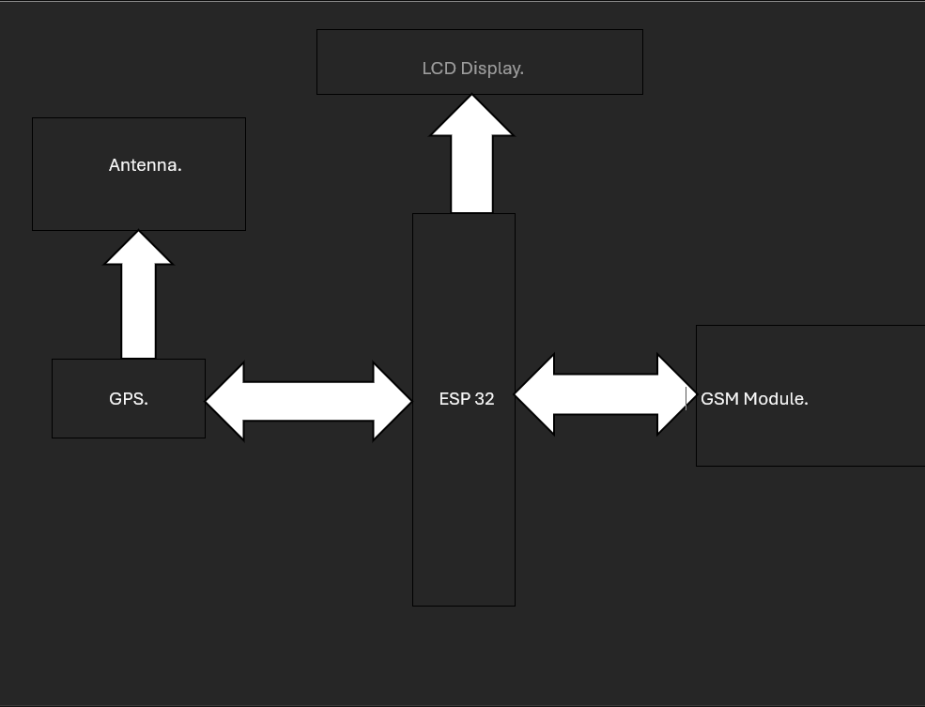
Architecture.

Slide 25
Objectives.
Accurate Toll Calculation
Key Features:
Distance-Based Charging:
OBUs communicate with satellites to calculate tolls based on actual distance traveled.
Ensures equitable and transparent charges (e.g., a 30 km trip incurs charges for 30 km only).
Real-Time Data Processing:
Advanced algorithms map vehicle movements for seamless toll fee calculation.
Automatic deductions from digital wallets enhance convenience.
User-Friendly Experience:
Frictionless payments reduce wait times at toll plazas.
Builds trust through accurate and automated toll deductions.

Slide 26
Objectives(cont...)
Toll Evasion Prevention
Technological Measures:
Automatic Number Plate Recognition (ANPR):
Gantry cameras capture registration plates for non-compliance detection.
Flags vehicles with tampered plates or inactive OBUs.
Monitoring and Surveillance:
CCTV cameras provide additional oversight and deter evasion attempts.
Penalties for Non-Compliance:
Vehicles without valid OBUs face higher penalties (e.g., double toll fees).
Encourages fair contributions to road maintenance and development.

Slide 27
Objectives(cont...)
Improved Safety
Enhancing Highway Safety:
Real-Time Traffic Monitoring:
Radar and GNSS analyze vehicle speeds to detect potential hazards.
Alerts notify traffic teams of incidents or slowdowns.
Dynamic Traffic Management:
Proactively redirects vehicles away from congested or hazardous areas.
Reduces bottlenecks and improves overall flow.
Enhanced User Awareness:
Drivers receive real-time updates on road conditions via apps or displays.
Promotes safer driving behaviors and adherence to speed limits.

Slide 28
Objectives(cont...)
Benefits of the GNSS System
Accuracy:
Eliminates manual errors and revenue leakage.
Precise toll calculation based on actual usage.
Convenience:
Automated, seamless payment processes improve user satisfaction.
Compliance:
Advanced surveillance and penalties reduce toll evasion.
Safety:
Real-time monitoring and alerts enhance road safety.

Slide 29
Objectives(cont...)
Challenges and Opportunities
Challenges:
Addressing privacy concerns with robust data protection measures.
Ensuring GPS and GSM reliability under varying conditions.
Overcoming public skepticism and ensuring fair pricing structures.
Opportunities:
Improves user trust through transparency and efficiency.
Supports infrastructure funding and environmental sustainability.

Slide 30
Outcomes.
Accurate Toll Calculation
Key Features:
Distance-Based Charging: Tolls calculated based on actual distance traveled, ensuring fairness and transparency.
Example: 30 km travel = toll calculated for 30 km.
Real-Time Data Processing: Advanced algorithms analyze vehicle movements instantly for seamless toll fee computation.
User-Friendly Experience: Automatic toll deductions from prepaid accounts or wallets, eliminating delays at toll booths.

Slide 31
Outcomes (cont…).
Real-Time Data Processing:
Advanced algorithms process vehicle movements instantaneously.
Digital image processing maps highway coordinates for precise toll calculation.
Benefit:
Seamless toll computation as vehicles pass through designated zones.

Slide 32
Outcomes (cont…)
Toll Evasion Prevention
Key Features:
Automatic Number Plate Recognition (ANPR): Gantries capture vehicle registration plates to flag non-compliance.
Monitoring and Surveillance: CCTV cameras deter evasion and ensure compliance through constant monitoring.
Penalties for Non-Compliance: Strict fines (e.g., double fees) for vehicles using GNSS lanes without valid OBUs.

Slide 33
Outcomes (cont…)
Improved Safety.
Real-Time Traffic Monitoring:
Continuous tracking of vehicle speeds and movements.
Alerts for sudden slowdowns or hazards to prevent accidents.
Dynamic Traffic Management:
Proactive routing strategies reduce congestion and bottlenecks.
Enhances traffic flow and minimizes collision risks.
Enhanced User Awareness:
Real-time updates on road conditions, hazards, and incidents via mobile apps or in-vehicle displays.
Promotes safer driving behavior and adherence to speed limits.

Slide 34
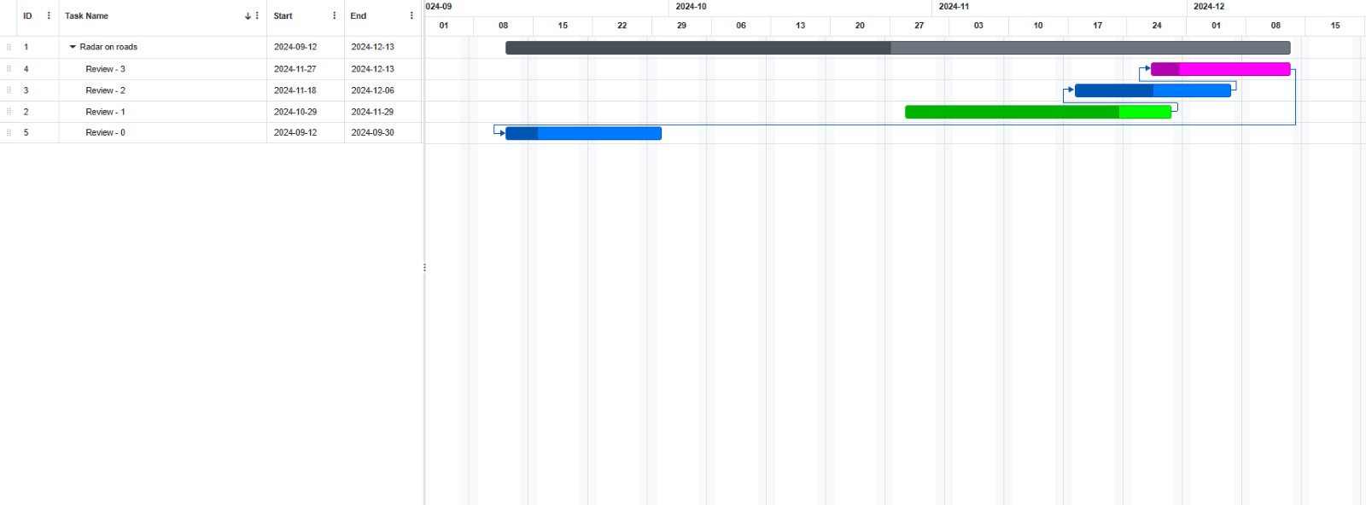
Timeline of the Project (Gantt Chart)

Slide 35
Conclusion.
In conclusion, Project Radar has set a strong foundation for future advancements in road management by demonstrating that technology can significantly enhance efficiency and user satisfaction while promoting sustainable practices in transportation management. The integration of advanced technologies into toll collection systems not only addresses long-standing issues but also paves the way for smarter, safer roads. Continued investment in research and development will be essential in overcoming existing challenges while maximizing the benefits offered by these innovative solutions. As cities evolve into smart urban centers, projects like Radar will play a crucial role in shaping the future of transportation infrastructure.

Slide 36
Github Link.
Github Link:
https://github.com/hiranshree/Radar-on-Roads.git

Slide 37
References (IEEE Paper format)
[1] Goutham, K., Gowtham, M., & Megalan Leo.L. (2023). GPS based e-toll gate collection system. Journal of Scientific Research and Reports, 26 June.
[2] Mahmood, F. M. Z. (2022). Vehicle tracking system by using GPS, GSM, and Arduino technology. Journal of Engineering Science and Technology Review, January.
[3] Chauhan, R. K., & Chauhan, K. (2021). Intelligent toll collection system for moving vehicles in India. International Journal of Engineering Research and Technology, 6 September.
[4] Ni Ni San Hlaing, Ma Naing, & San San Naing. (2019). GPS and GSM based vehicle tracking system. International Journal of Advanced Research in Science, Communication and Technology, 3(4).
[5] Saddam. (2016). Arduino based vehicle tracker using GPS and GSM. International Journal of Advance Research, Ideas and Innovations in Technology, 3(4), March.

Slide 38
References (IEEE Paper format)(cont…)
[6] Anandaraj, S., & Mohana Arasi, M. (2016). Intelligent toll path system using GPS and GSM. International Journal of Advanced Research in Computer Science, 5(5), May.
[7] Sathya, V., & Samath, A. (2013). Automatic toll collection centre (ATCC) using GSM/GPS proposal for Indian toll booths. International Journal of Engineering Research and Applications, 15 July.
[8] Kamble, K. P. (2012). Smart vehicle tracking system. International Journal of Advanced Research in Computer Science, 3(4), July.
[9] Nowacki, G., Mitraszeweska, I., & Kaminski, T. M. (2009). GSM/GPS based toll collection system – Proposal for Poland. Journal of Telecommunications and Information Technology, June.
[10] Persad, K., Walton, C. M., & Hussain, S. (2007). Toll collection technology and best practices: Project 0-5217: Vehicle/license plate identification for toll collection applications. Texas Transportation Institute.

Slide 39

Project work mapping with SDG.
SDG 8. Decent work and Economic Growth.
SDG 9. Industry Innovation and Infrastructure.
SDG 10. Reduced Inequalities.
SDG 12. Responsible consumption and production.
SDG 17. Partnership for the goals.

Slide 40


